Slide 1
Why (and how) should we study Question Answering?
Dan Roth
Computer and Information Science
University of Pennsylvania
Reasoning for Complex Question Answering
AAAI-20 Workshop
February 2020
Notes:
So a lot of people talked about some great progress. But I will talk about challenges – so you can go home and think about all the great things that you still have to work on.

Slide 2
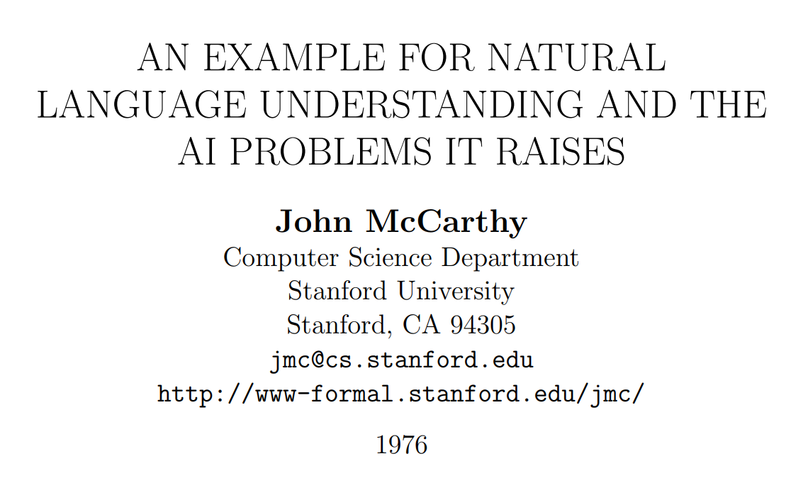
What is Complex Question Answering?

Slide 3
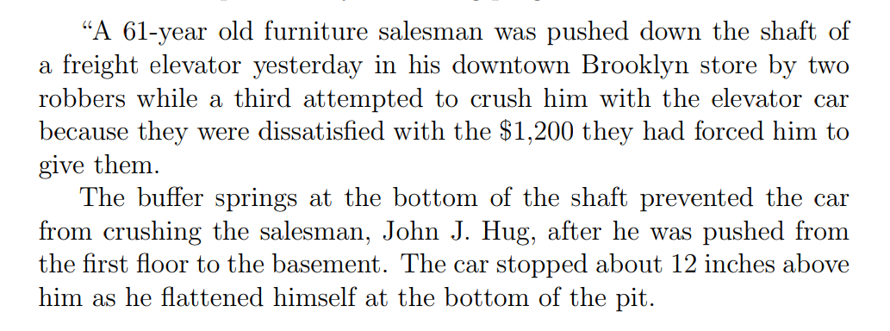
A New York Times Story

Slide 4
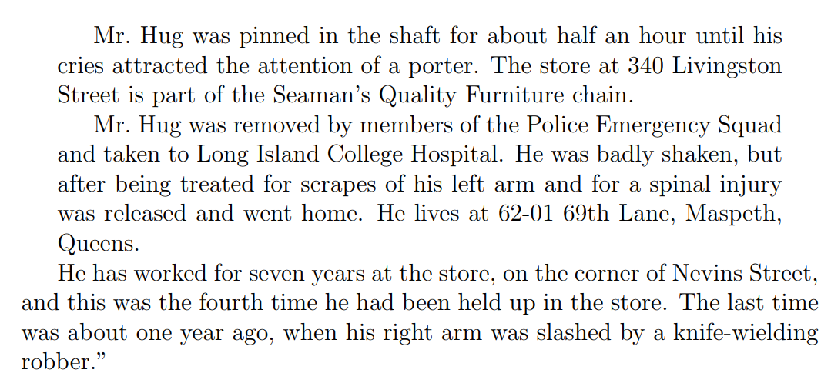
A New York Times Story (Cont.)

Slide 5
New York Times Story: Questions
An intelligent person or program should be able to answer the following questions based on the information in the story:
The article proceeds with 22 questions:
1. Who was in the store when the events began?
2. What did the porter say to the robbers?
20. Why did Mr. Hug yell from the bottom of the elevator shaft?
“The above list of questions is rather random. I doubt it covers all facets of understanding the story.”

Slide 6
New York Times Story: Questions
An intelligent person or program should be able to answer the following questions based on the information in the story:
The article proceeds with 22 questions:
1. Who was in the store when the events began?
Probably Mr. Hug alone, although the robbers might have been waiting for him, but if so, this would have been stated.
2. What did the porter say to the robbers?
Nothing, because the robbers left before he came.
20. Why did Mr. Hug yell from the bottom of the elevator shaft?
So as to attract the attention of someone who would rescue him.
“The above list of questions is rather random. I doubt it covers all facets of understanding the story.”

Slide 7





Let’s Talk about this News Story
Who was in the store when the events began?
The story doesn’t say.
Probably Mr. Hug alone, although the robbers might have been waiting for him, but if so, this would have been stated.
Why did Mr. Hug yell from the bottom of the elevator shaft?
The story doesn’t say.
So as to attract the attention of someone who would rescue him.
Understanding the story and conversing about it require Situated Reasoning: Model-based Reasoning
[Example due to John McCarthy]

Slide 8
McCarthy’s Challenges
The QA module is not being trained Once the program knows English, and has the relevant background knowledge, it should answer the questions
A formalism capable of expressing the assertion of the sentences free from dependence on the grammar of the English language.
Semantic Parser
An “understander” that constructs the “facts” from the text.
Information Extraction: Entities, Relations, Temporal, Quantities,…
Expression of the “general information” about the world that could allow getting the answers to the questions from the “facts” and the “general information”
Background Knowledge
A “problem solver” that could answer the above questions on the basis of the “facts”.
Question Answering Engine
The challenge is not to answer questions that are directly addressed in the text. Understanding is providing answers that are implied from the text.

Slide 9
Lessons
What can we learn from this example?
Difficulties of NLU
Importance of reasoning
“no one” is very unsatisfactory as a response to “Who was in the store with Mr. Hug”?
“Reasoning is about providing reasons”
Decoupling learning from reasoning
McCarthy thinks that there is a need for some level of abstraction – an abstract representation of the text and the relevant knowledge so that a generic module can work.
The questions are “surprising”; you have never seen it before – nevertheless, it’s easy to respond.

Slide 10
(2) Let’s Talk about Dinner
∃ r ∈ Restaurants | Cuisine(r, Mexican)∧ InCity(PH)
Constraints:
∀ r ∈ Restaurants → Contains(r, m) ∧ Menus(m)
∀ m ∈ Menus → Contains(d,m) ∧ Dishes(d)
∃ o ∈ Dishes → Tastes(o, ￢spicy)
→ Let’s talk about dinner.
A: Where do you want to go?
→ I really enjoy Mexican food, but not when it is spicy.
A: How about a Mexican restaurant with plenty of non-spicy options?
→ Yep, is there one in Philadelphia?
A: Here are a couple of good options
…….
Don’t worry, you can still use neural embeddings for the predicates and functions…
But the abstraction necessitates that we incorporate declarative constraints…
[Example due to Tania Berdax-Weiss]

Slide 11
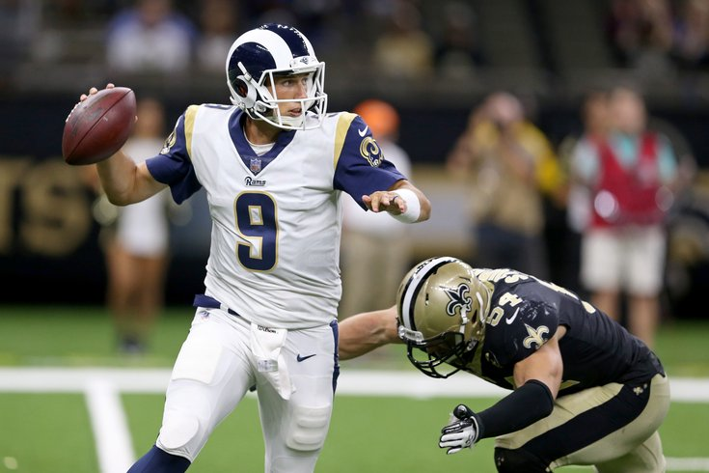
(3) Some questions to my Sports’ Assistant
Modified version of a question from AI2’s DROP dataset
Coming off a road win over the Cowboys, the Redskins traveled to Lincoln Financial Field for a Week 5 NFC East duel with the Philadelphia Eagles. In the first quarter, the Redskins trailed early as RB Brian Westbrook scored on a 9-yard TD run and the Eagles DeSean Jackson returned a punt 68 yards for a touchdown. Washington still trailed at half time 14:9, with field goals from Shaun Suisham. In the third quarter, the Redskins took the lead on a trick play as WR Antwaan Randle El threw an 18-yard TD pass to TE Chris Cooley. In the fourth quarter, the Redskins increased their lead when Clinton Portis scored on a 4-yard TD run. The Eagles managed one more score in the final quarter for a final score of 17:23.
How many touchdowns did the Eagles score in the first quarter?
Answer: 2
How do you know?
How many field goals did Washington score?
Answer: 3
→ Need a resource – the rules of the game.
How many field goals did the Eagles score?
Answer: 1
The answer isn’t available in any KB, but can be gleaned from the recap.
Semantic parsing is harder: it involves executing programs on the text
Count(scoring team=Eagles (identify TD, scoring team))
[Nitish Gupta et al. ICLR’20]: poster was presented today
Football Scoring Rule Book:
TD could be 6, 7, or 8 points.
Kick….
Field goal is worth 3 points
…..
General rules that are to be instantiated….
What computational tasks should we think about?
“Discrete” Reasoning is essential here. And, how/what should we train?

Slide 12
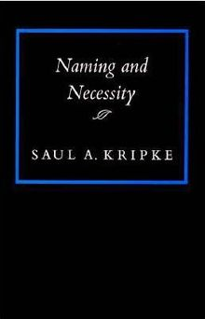
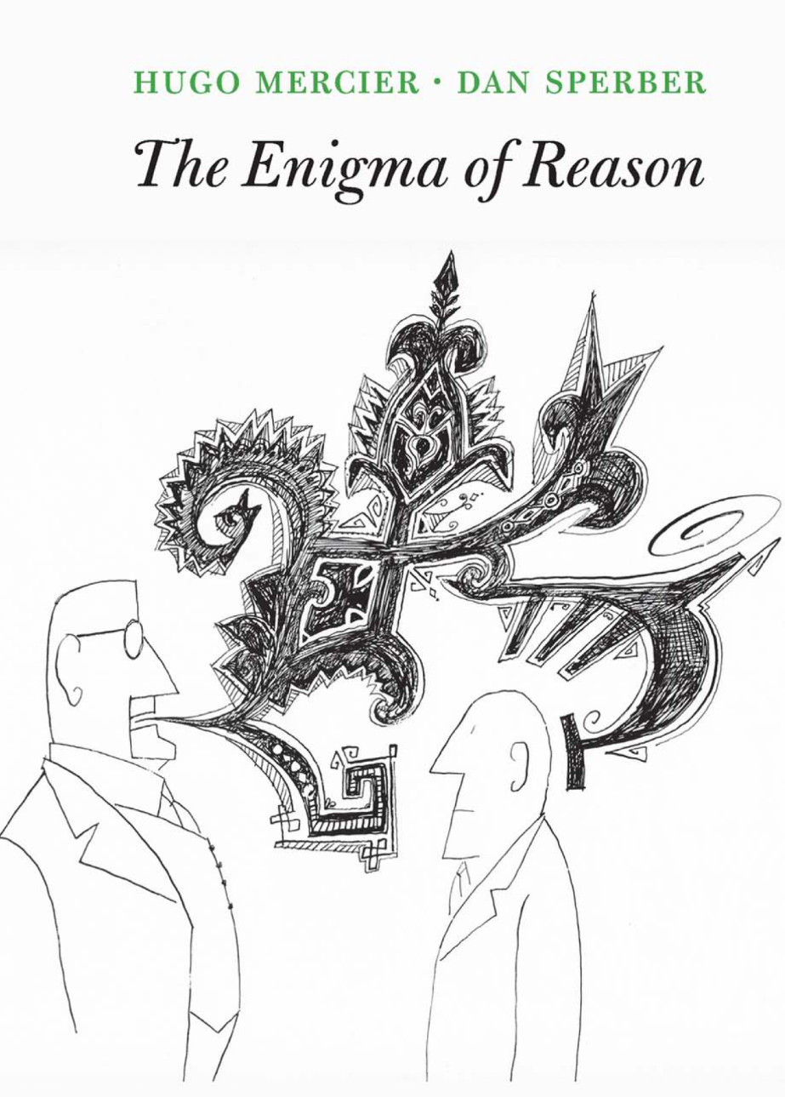
Symbolic Reasoning?
Some people think that symbols are an evil invention of old AI people.
It’s not.
Language is a symbolic system
Table is a collection of things in world.
Even though we communicate via speech, gestures, writing, which are continuous, symbols are the invariants of this communication.
Harari: Language – the ability to assign symbols to “things” and “reason” about them is key to human cognitive revolution
Kripke: “Naming” things is key to communication and to cognition
The Enigma of Reason: “Reasoning is about giving reasons”

Slide 13
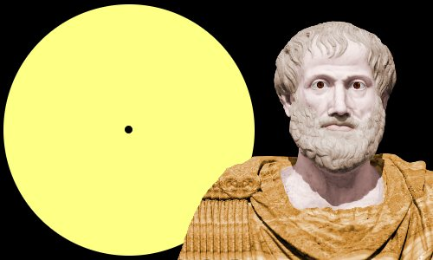
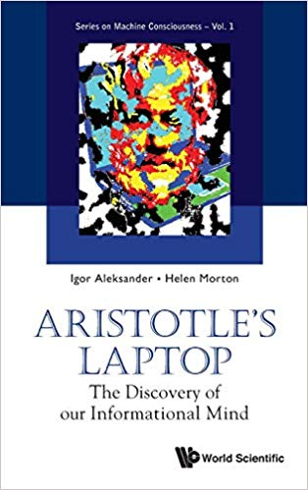
Aristotle’s Logic https://www.famousscientists.org/aristotle/
Aristotle founded the study of formal logic, systematizing logical arguments – he is famous for the syllogism, a method by which known information can be used to prove a point.
Here is a famous example, from Aristotle himself, of a simple syllogism:
All men are mortal.
Socrates is a man.
Therefore, Socrates is mortal.
So, did Aristotle have a laptop?
[Example due to Les Valiant]
Notes:
Google will say yes!

Slide 14
Key Challenges to NLU Researchers
Today’s NLP addresses well-defined tasks for which we have, or can generate, a lot of training data, but:
Who asks the questions?
~~ When did Aristotle die?
~~ When was the laptop invented?
What happened first?
The question isn’t if we need reasoning, but rather:
How to do it?
E.g., how to determine “strategies” on the fly?
How to train for it?
How can we supervise for these “sparse” events? [A different talk: On Incidental Supervision]
Should we learn “everything” together? When/how should we decouple/decompose tasks?
Not a new set of questions [Khardon & Roth, Learning to Reason, JACM’1996]

Slide 15
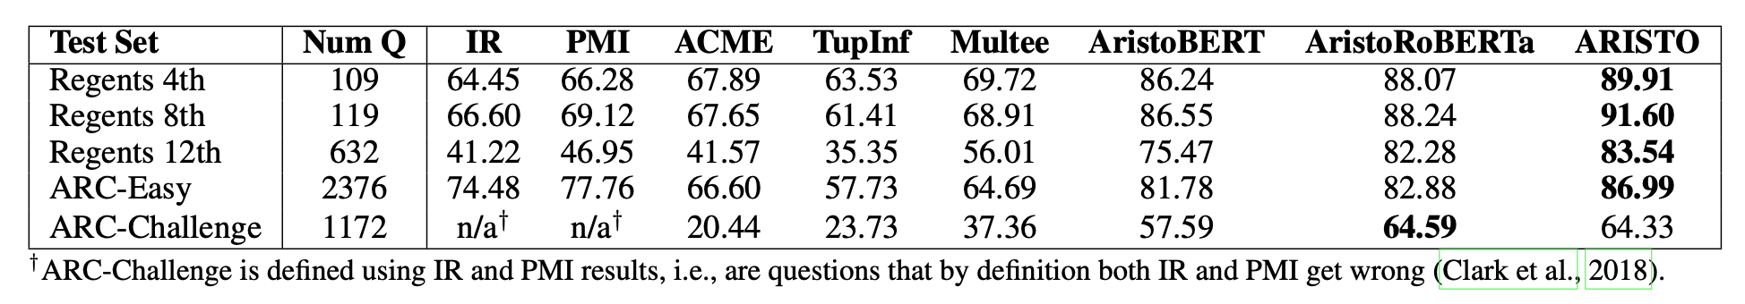
Are we Doing Any Reasoning Now?
Very little, if at all.
Not only because “we are asking the questions”
Clark et al 2019: On the success of AI2’s ARISTO Project:
From ‘F’ to ‘A’ on the N.Y. Regents Science Exams: An Overview of the Aristo Project
Very impressive results. But does it do reasoning?

Slide 16
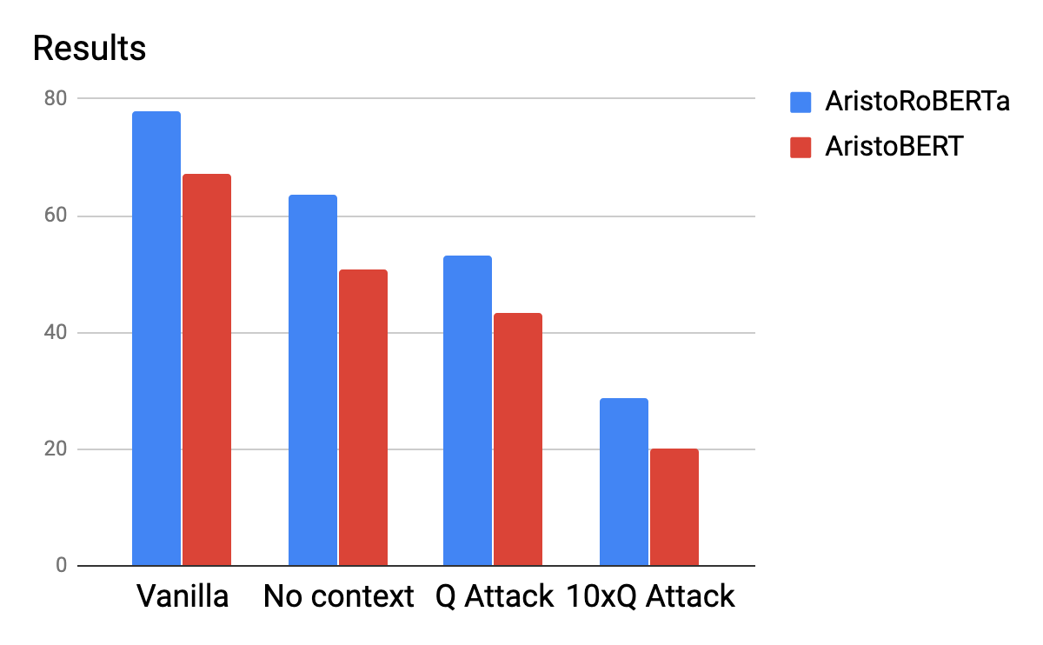
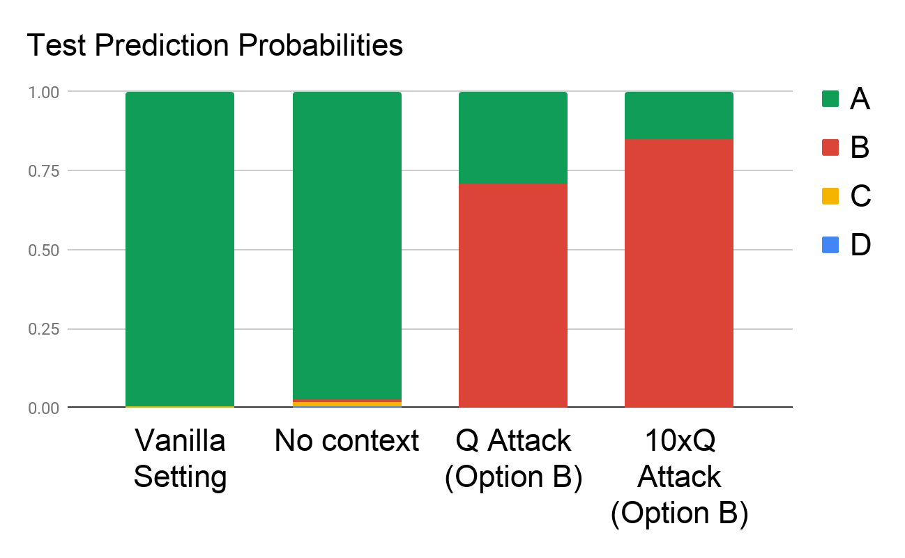
A Scientific QA Example [Shah et al. In Submission]
Question: The rate at which a wave passes through a medium is known as its
Answer Options:
speed
amplitude
acceleration
wavelength
Supporting Contexts:
The speed of a wave is the rate at which vibrations propagate through the medium…
The greater the amplitude of vibrations of the particles of the medium, the greater…
… hydrophones measure the acceleration of the medium as a seismic wave passes…
The speed of an electromagnetic wave in a medium depends on its wavelength. As…
Question Question Question Question Question Question Question Question……
Question
Are we doing Reasoning?

Slide 17
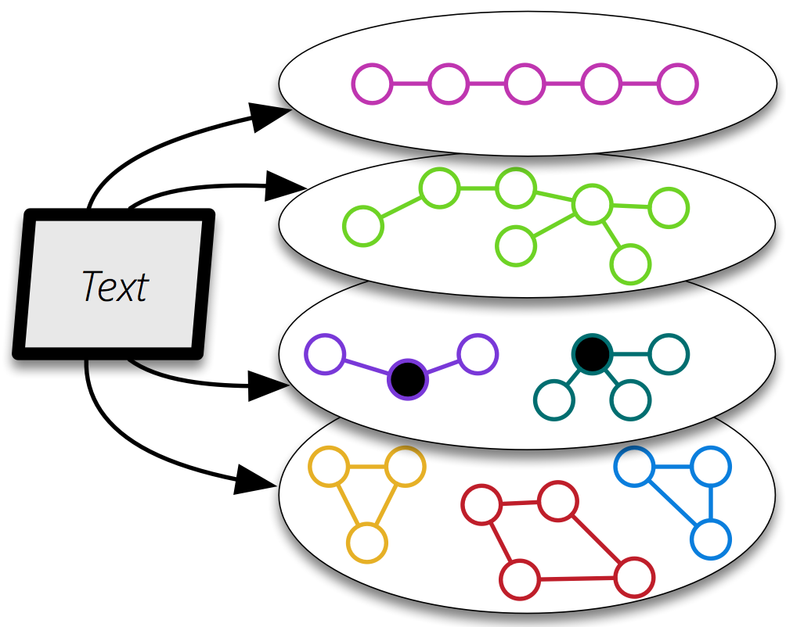
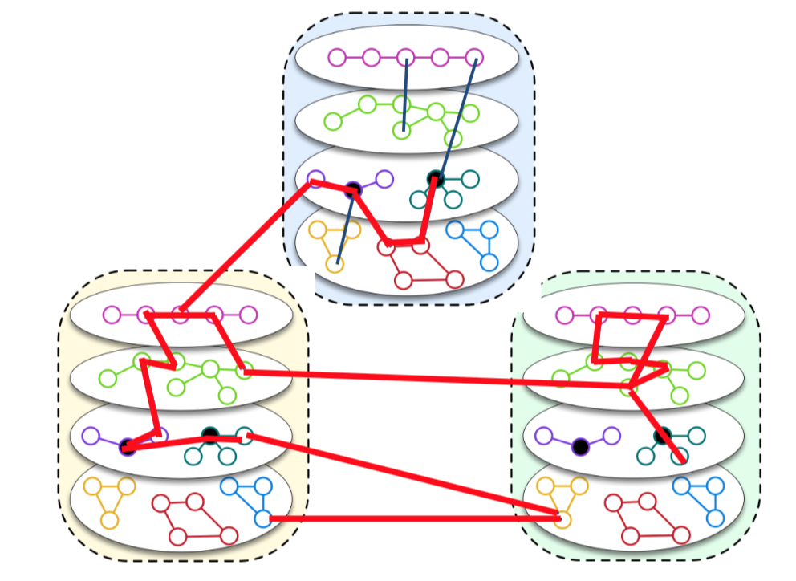
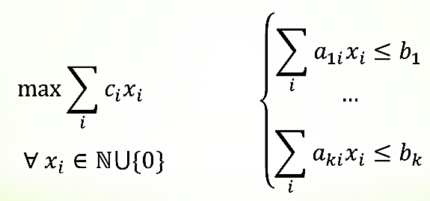
QA via Inference over Semantic Graphs [Khashabi et. al AAAI’18]
(An optimization method that recovered from the differentiability virus)
Addressing “sparse” QA challenges that one cannot train for directly
Create a unified representation of families of graphs (symbolic + continuous).
Use constrained optimization for inference over it.
Allows us to think about abductive inference – the best explanation given observations and knowledge
skip
Robust, due to a stronger notion of modularity
Easier to bring in:
previously trained models
Knowledge: declarative and statistical
Not a QA specific representation
Components can be as neural as you want
Notes:
To show you the big picture, we form an abstraction of text, as a collection of semantic graphs.
- Each instantiation of the graphs, can contain a different phenomena over text, with nodes being mentions within your text.
- Nodes could contain embeddings/representations that will be used during the reasoning time to create alignments.
I’d like to emphasize that such representations has nothing to do with the QA task. It is purely generic, and it reflects an understanding of the language. consequently, we expect these representations to be useful for a range of tasks;
============
also, they are to be learned from/as part of/ a range of tasks.

Slide 18
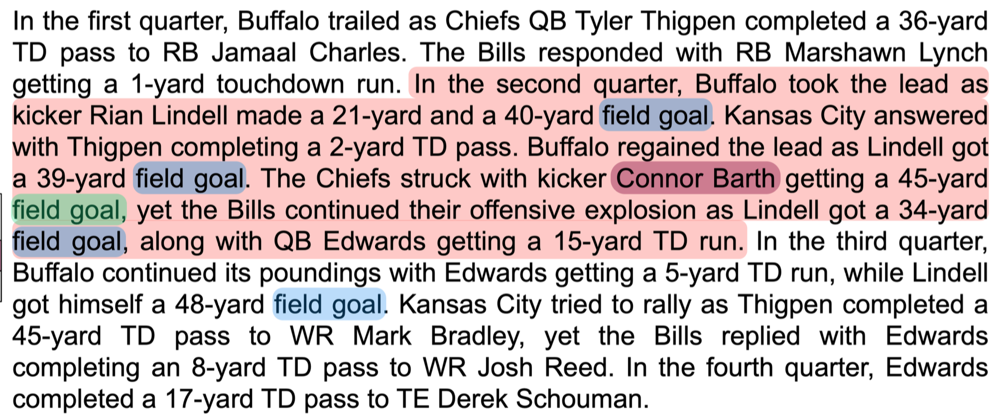
Reasoning over paragraphs

Slide 19
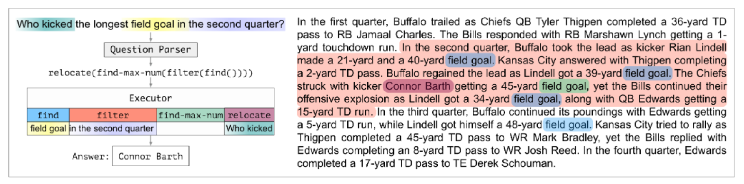
Neural Module Networks for Reasoning over Text [Nitish Gupta et al. ICLR’20]
A big step in the right direction
Goal: Decomposition for Reasoning about Text
We need to induce a program, with some executable modules at the leaves
“This phrase” indicates a field goal
“This player” scored it; “this is the team” that scored it
“This is the length” of the field goal
Reason symbolically over it.
Imagine more expressive functions
But, how to bring in previously learned models and knowledge from outside is tricky….
You don’t want to assume that you learned MAX by reading a lot of football recaps…
Colors represent levels of attention over phrases

Slide 20
Aristotle’s Logic https://www.famousscientists.org/aristotle/
Aristotle founded the study of formal logic, systematizing logical arguments – he is famous for the syllogism, a method by which known information can be used to prove a point.
Here is a famous example, from Aristotle himself, of a simple syllogism:
All men are mortal.
Socrates is a man.
Therefore, Socrates is mortal.
So, did Aristotle have a laptop?
[Example due to Les Valiant]
Notes:
Google will say yes!

Slide 21
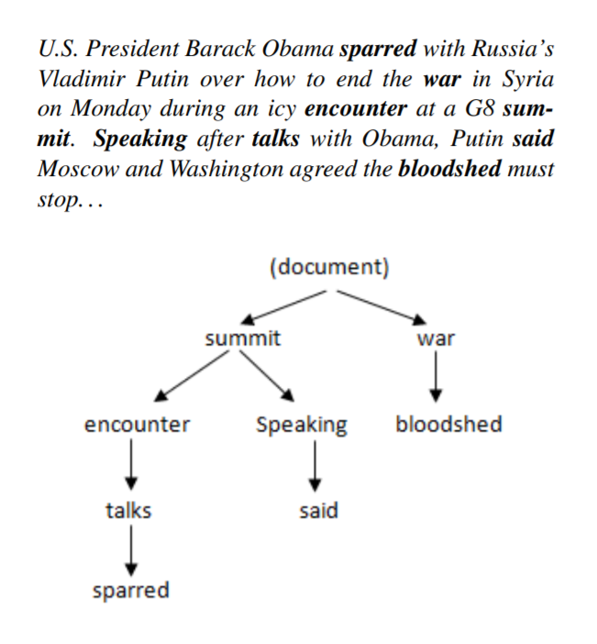
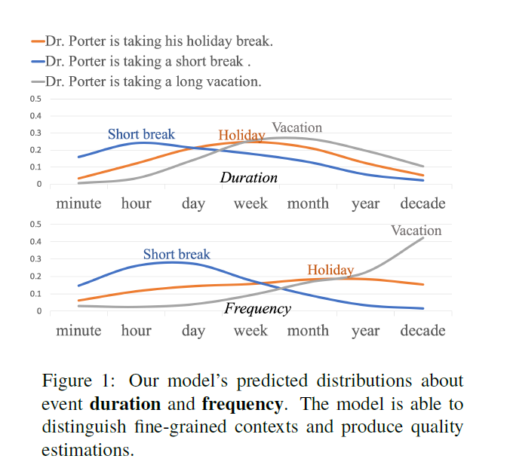
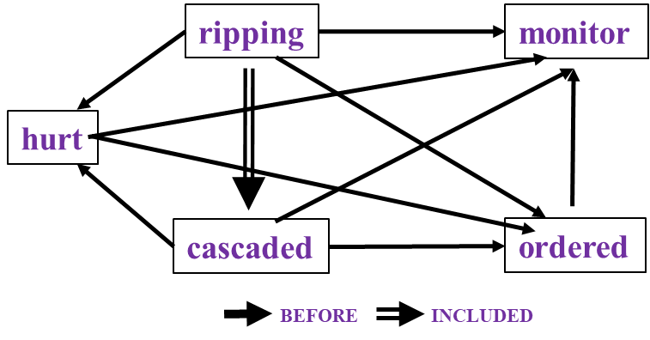
Reasoning about Time and Events
Temporal relations between events
Hierarchical relations between events
Temporal Commonsense
Study them independently and develop approaches to study them as interrelated tasks
In Los Angeles that lesson was brought home today when tons of earth cascaded down a hillside, ripping two houses from their foundations. No one was hurt, but firefighters ordered the evacuation of nearby homes and said they'll monitor the shifting ground until March 23rd.

Slide 22
A Revolution in Temporal Reasoning
Generalized common sense
Involves reasoning with external knowledge.
Declarative knowledge
Transitivity
Statistical knowledge
commonsense knowledge.
BERT
Neural + ILP
+3%
Axes dataset
+4%
Common sense
+3%
Structured learning
+11%*
Previous SOTA
+4%
+2%
2015
2017
2019
Thesis work of Qiang Ning (2019)
Notes:
This is a final summary for our progress on this task. CAEVO is the previous SOTA, structured learning 2%, common sense 4%, new dataset 11%, LSTM with standard word embeddings 3%, LSTM with BERT embeddings 4% (BERT is the most recent word embedding), and Siamese another 3%.

Slide 23
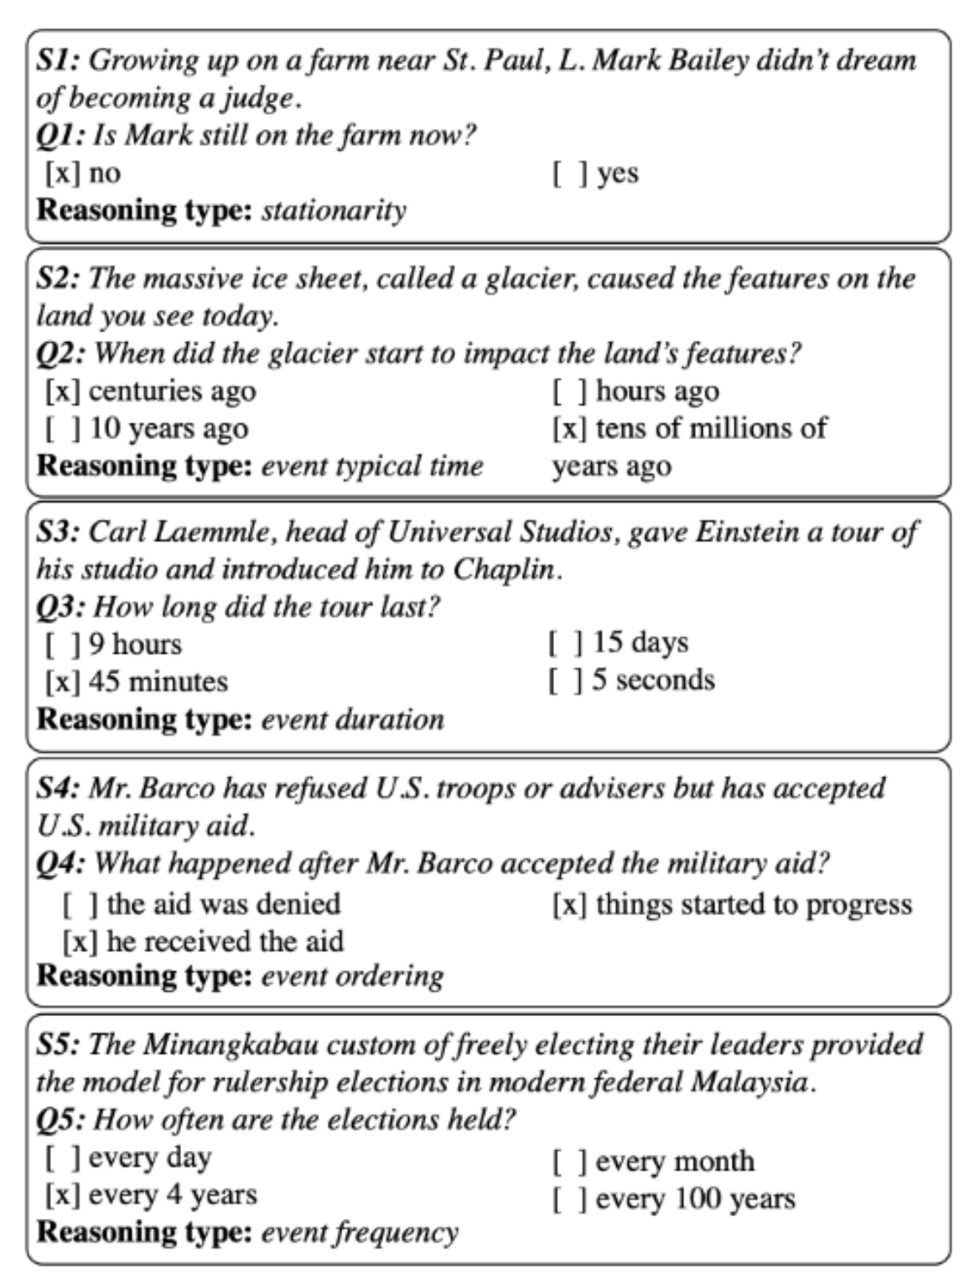
MC-TACO🌮: A Temporal Commonsense Dataset [Zhou et al. EMNLP’19]
A new QA data set that addresses some temporal reasoning tasks. (Along with a baseline approach)
Paul Simon is in NYC. Let’s go see him.
The Empire State Building is in NYC.
The results of BERT-based models are very low. Not surprising given the need to have commonsense.
Perhaps more importantly, it illustrates the need to decompose, and know how to incorporate knowledge.
Typical Time
Will we make it to dinner before the movie?
Event Frequency

Slide 24
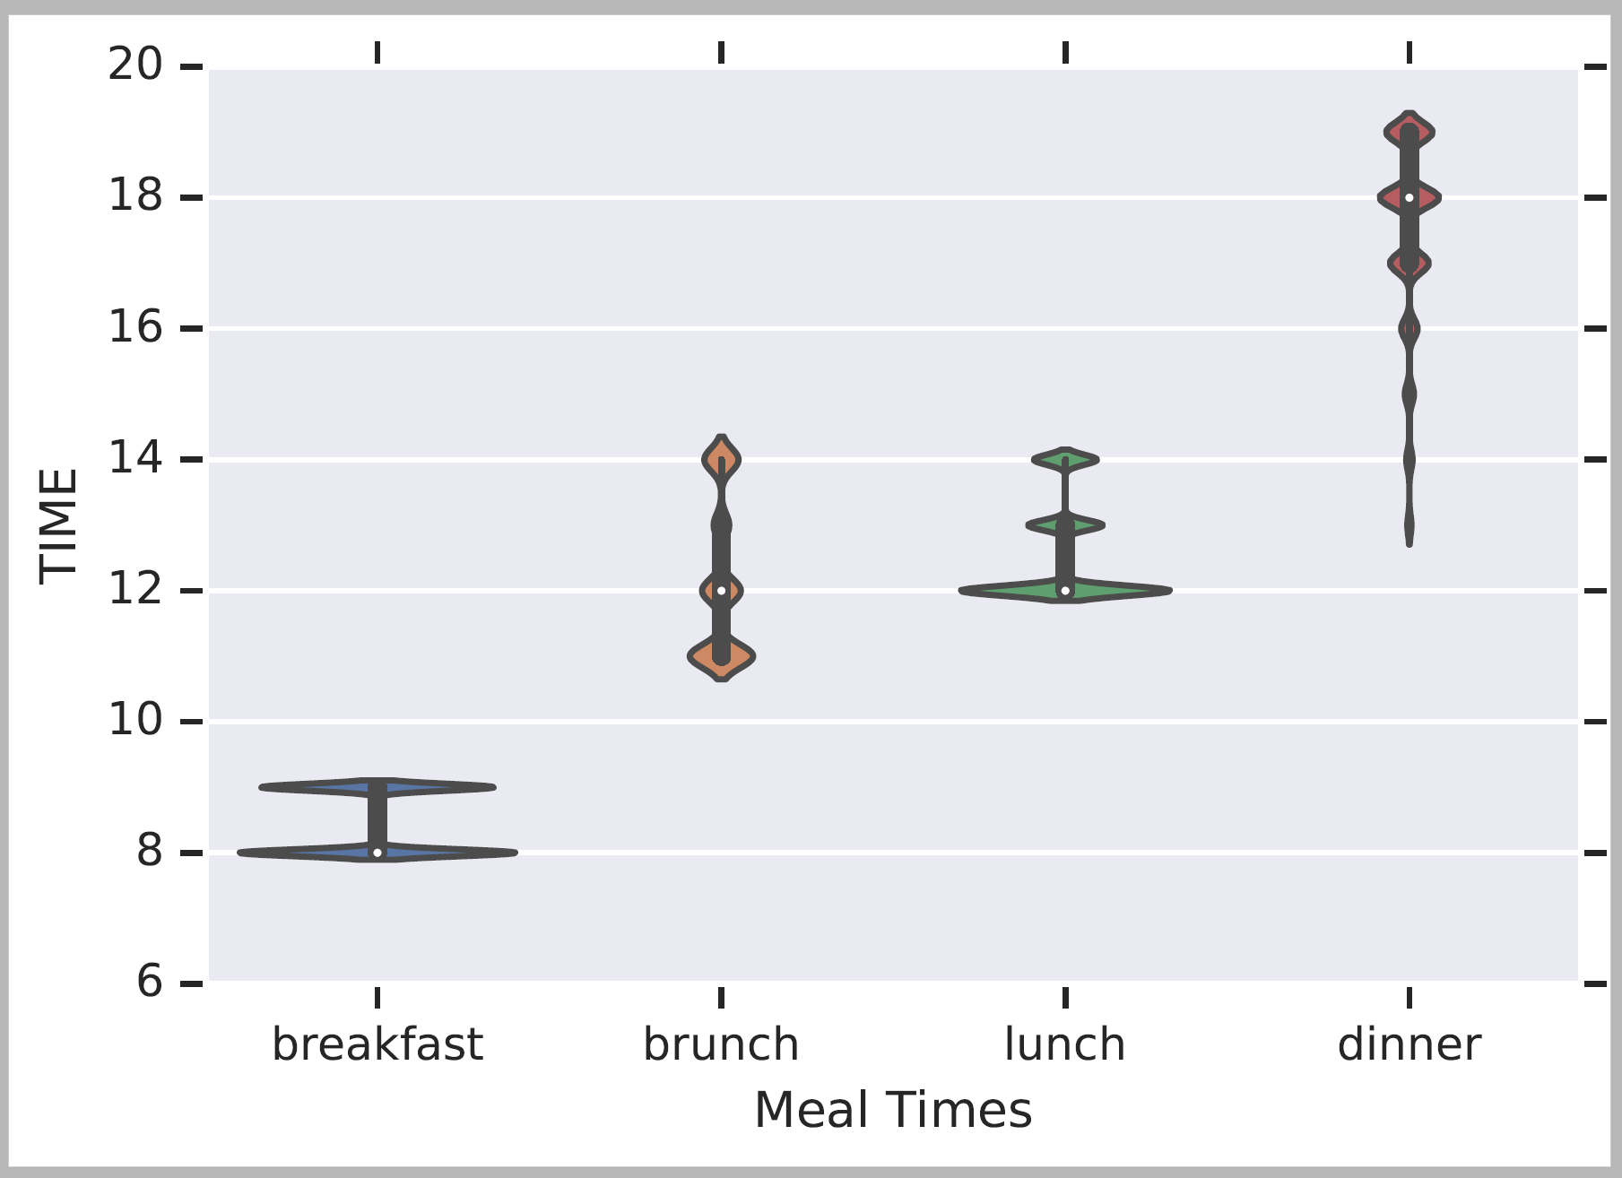
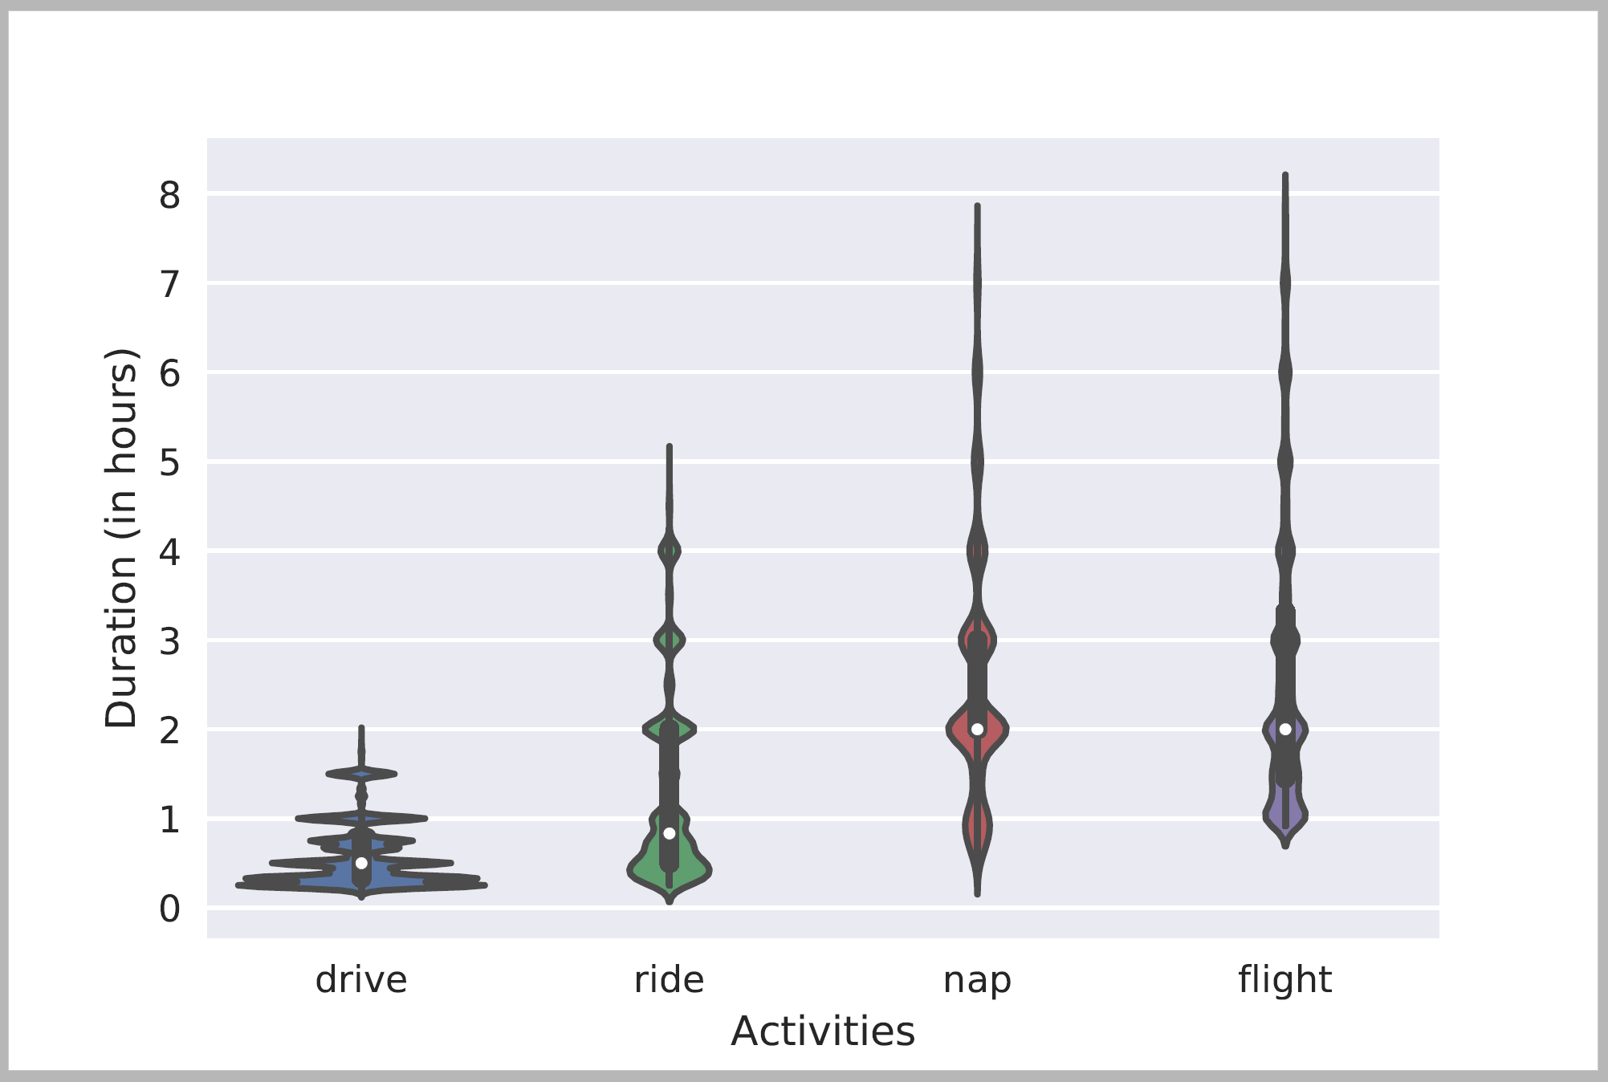
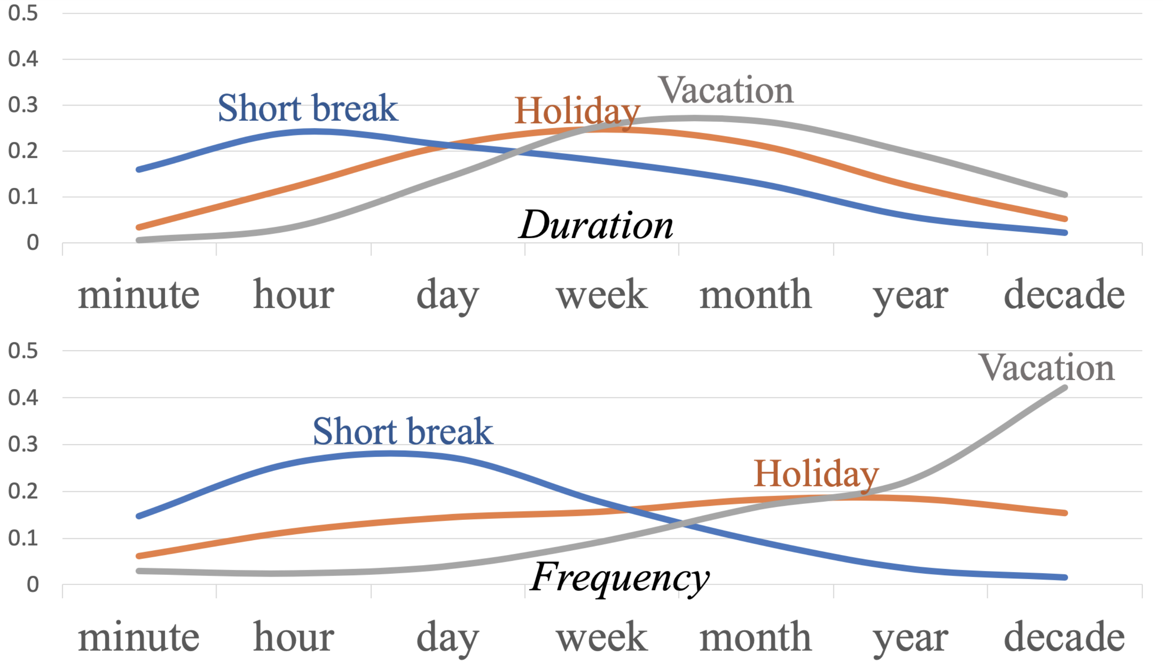
Acquiring Temporal Commonsense
But we still don’t know if Aristotle had a laptop. Nor if we will make it to dinner before the movie.
Temporal order of events:
[Ning et al. NAACL’2018]
Jointly modeling multiple temporal aspects
Contextual modeling
In submission
Distributions over quantities:
[Elazar et al, ACL’19]
Typical Time
Duration

Slide 25
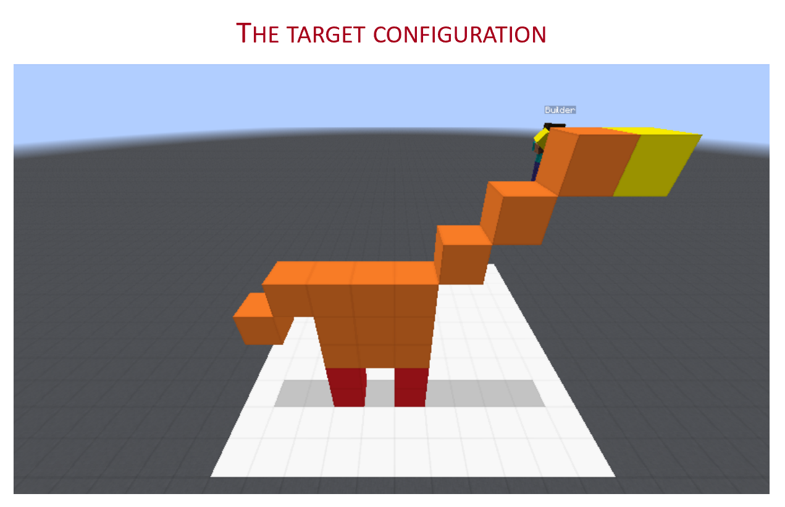
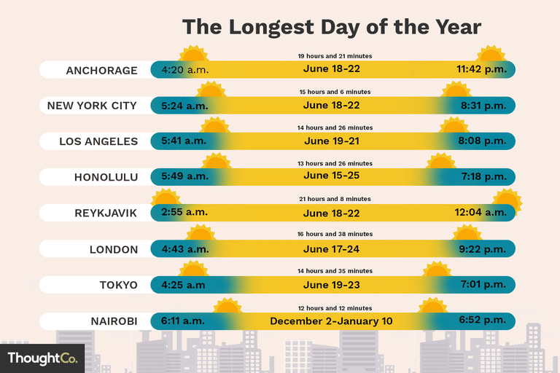
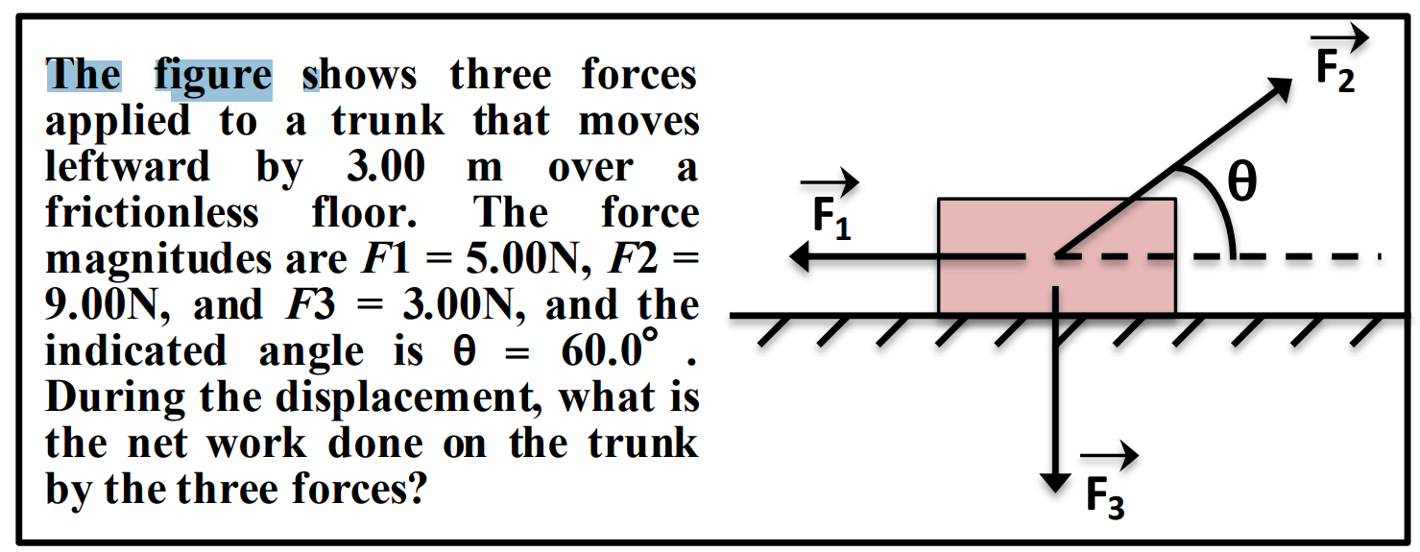
Conclusion
Thank You!
Question answering is a way to probe our understanding of language and the world.
And sometimes, a way to induce representations that will help us doing do.
I tried to articulate some of the challenges.
And a sample of recent advances from a research program that attempts to address some of the key scientific and engineering challenges between us and understanding natural language.

